Slide 1

Rangitāne o Wairau Settlement Trust
and
Te Rūnanga a Rangitāne o Wairau Trust
Annual General Meetings
Ūkaipō, Grovetown
Saturday 28 October 2017, 10:30am

Slide 2
Mihimihi
Mihi Whakatau / Karakia / Hīmene
Introductions
  Trustees
  Directors
  Staff
  Advisors
  Health & Safety
Present
Apologies
Notes:
JEREMY
HAYSLEY
WENDY
Ko Kurahaupo te waka
Ko Tapuwae o Uenuku te maunga
Ko Wairau te awa
Ko Rangitane o Wairau te iwi
Kia ora mai tatou katoa
I am Wendy Hynes, I am one of the three current Trustees and I’m also the Interim Chairperson.
On behalf of the Trustees, welcome to Ukaipo, welcome to your Annual General Meeting.
Our hope is that we all leave this hui today feeling informed and ready to move forward together.
To my left is Corey Hebberd, he will be taking our minutes today. When you speak please clearly state your name for the minutes.
SIR MARK SOLOMON -
The purpose of this AGM is to report on the year that ended 31/3/2016. In some respects that presents challenges for the current Trustees because the flow of information has been limited.
We need to move through the AGM business in a respectful manner where everyone will get the opportunity to speak to the issues and we all leave with our mana intact ready to move forward together
To help us achieve that, the Trustees have asked Sir Mark Solomon to facilitate today’s AGM. Sir Mark is one of the most respected leaders in Te Ao Maori who has whakapapa connections to us and existing relationships with Rangitane o Wairau at iwi, governance and management levels. Please join us in welcoming Ta Mark Solomon.
TA MARK TO INTRODUCE HIMSELF
HOUSEKEEPING – Liz McElhinney, General Manager

Slide 3
Tānenuiarangi
Tāne nui a Rangi o Rangitāne tangata rau Hoki mai rā ki te Āputa ki Wairau Haere mai rā e Ngā tāngata o Arapaoa Haere e whai Te Tapuae o Uenuku Kia ora ai te tāngata O Te Aroha o Te Waipounamu eeeeiii

Slide 4
Purpose of AGM
To consider:
the Annual Report
the Annual Plan
the Asset Holding Company Report (within the Annual Report)
any proposal to change the constitutional documents

Slide 5
Vote Collection
Isiah Roberts from Electionz.com
Anyone who has a voting paper with them can put it in the ballot box in the Election room
Anyone who wishes to register and vote at the same time can do so in the Election room

Slide 6
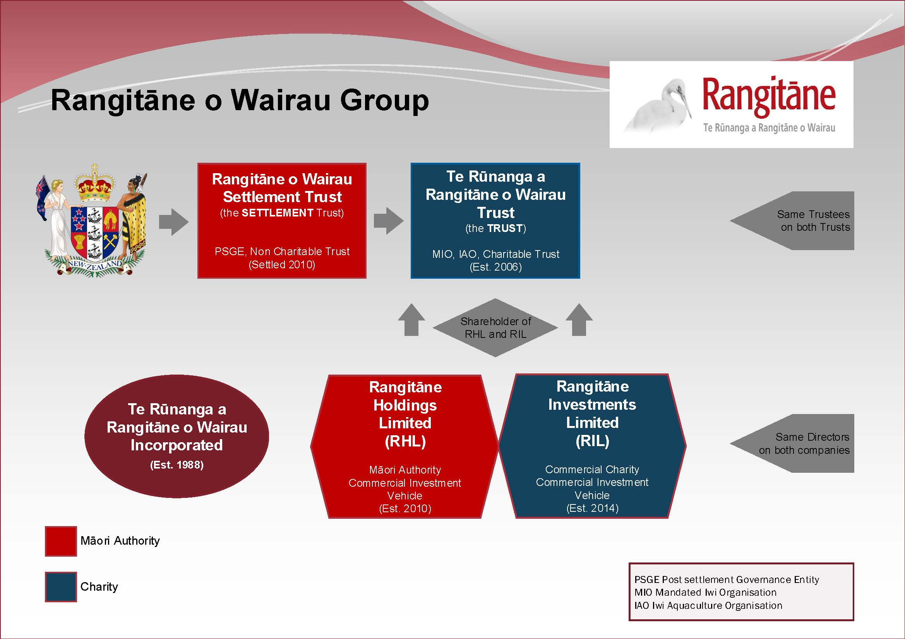

Slide 7
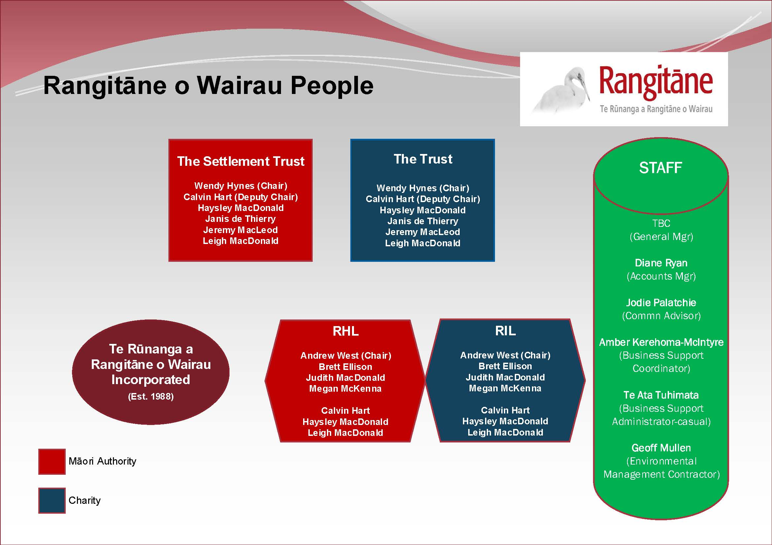

Slide 8
Terminology
RoW – Rangitāne o Wairau
The Settlement Trust –
Rangitāne o Wairau Settlement Trust
The Trust –
Te Rūnanga a Rangitāne o Wairau Trust
The Inc –
Te Rūnanga a Rangitāne o Wairau Incorporated
RHL – Rangitāne Holdings Limited
RIL – Rangitāne Investments Limited
MBC – Marlborough Boys’ College

Slide 9
Agenda 1 – Settlement Trust
Rangitāne O Wairau Settlement Trust
(Year Ended 31/3/2017)
Karakia/Mihimihi
Present/Apologies
Confirmation of minutes 18/2/2017
Annual Report and Plan for Settlement Trust
Confirmation of Trustees
Appointment of Auditor
General Business
Closure of Settlement Trust business

Slide 10
Agenda 2 – The Trust
Te Rūnanga a Rangitāne o Wairau Trust
(Year Ended 31/3/2017)
Present/Apologies
Confirmation of minutes 18/2/2017
Annual Report and Plan for the Trust
Annual Report and Plan for RHL and RIL
Confirmation of Trustees
Appointment of Auditor
General Business
Closing of Trust business
Karakia whakamutunga

Slide 11
Annual General Meetings
The Trust Deeds require that an Annual General Meeting be held for both:
  The Settlement Trust and
  The Trust
The Annual Report 2017 is a consolidated view of reporting and planning for the whole Group
The business of the Settlement Trust is transacted by the Trust

Slide 12
Motion
Due to the consolidation
of annual reporting and planning
in the Annual Report
and to avoid duplication,
all agenda items be deferred
to and included in the AGM for
Te Rūnanga a Rangitāne o Wairau Trust
Close Rangitane o Wairau Settlement Trust AGM

Slide 13
Te Rūnanga a Rangitāne o Wairau Trust
AGENDA
Present/Apologies
Confirmation of minutes 18/2/2017
Annual Report/Plan for the Trust
Annual Report/Plan for RHL and RIL
Confirmation of Trustees
Appointment of Auditor
General Business
Closing of Trust business
Karakia whakamutunga

Slide 14
Previous Minutes
AGM 18 February 2017
Corrections
Clarification
Changes
Confirmation

Slide 15
Annual Report
Chairperson’s Report
Financial Report
  Kendons, Dylan Stewart and Alastair Lloyd
Audit Report
  Deloitte, Trevor Deed
Legal Issues
  Kahui Legal, Damian Stone
  Radich Law, Peter Radich
RHL/RIL Report
  Directors, Andrew West and Judith MacDonald

Slide 16
Chairperson’s Report
Taken as read
Questions?
Our People
  Kaumātua (Moira Carey)
  Hauora (Lauree Ashworth)
  Putea Tautoko (Lauree Ashworth)
  Rangatahi (Te Ata Tuhimata)
  Te Kohi Kai (Rick Andrell)
  Mātauranga (Pikihuia Reihana)
Our Culture and Language (Janis de Thierry/Jeremy MacLeod)
Our Organisational Management (Leigh MacDonald)
Our Environment (Geoff Mullen)

Slide 17
Our Culture and Language
Te Reo Māori strategy
Kurawhakarauora 3-5 November – Ōmaka

Slide 18
Organisational Management
HR policies, procedures and templates
Health & Safety management plan
Standardising employment agreements
Sick leave allocation
General Manager recruitment update

Slide 19
Our Environment
Current initiatives underway:
Environmental Management Plan with values based policy statements
Te Pokohiwi management plan and protection
Wairau Lagoon and protection mechanisms
Marlborough Environment Plan
Kaitiaki training programme

Slide 20
Our Financial Operation
Financial Report
New policies & procedures were finalised
  Followed review in 2016
  Allow for better & more consistent financial control
  Includes cash handling, payment authorisation, and travel expenses
  Included delegated authorities
Continued with monthly management reporting to inform the Trustees
Continued reviewing and assisting with the regular IRD return filing

Slide 21
Financial Report
Statement of Financial Performance
Group Income $2.4m (2016: $2.4m)
Group Expenditure $2.5m (2016: $1.9m)
  Salaries, Wages Contractors ($617k)
  Legal Fees ($274k)
  General Expenses ($512k)
Group Profit $358k (2016: $2.7m)
Return on Assets in RHL/RIL of 5.6%

Slide 22
Financial Report
Statement of Financial Position
Total Trust Funds increased to $43.9m
Total Assets of $44.1m
Transferred significant cash to term deposits for higher yields
Shares and fish quota values have increased
Property values are based on the original
  Complete valuation in 2018

Slide 23
Financial Report
Salaries, Wages and Contractors
Legal Fees
General Expenses

Slide 24
Audit Report - Process
The 2017 Audit process is unchanged from prior years
Deloitte audit the Financial Statements of each entity as requested by the Trustees
No specific audit work was undertaken on the “Red Paper” by agreement

Slide 25
Audit Result
The Trust and Group opinions were issued on 2 August 2017
They are all “clean” and unqualified
No changes to accounting policies or assets
Key judgements implicit in these by Trustees and Directors are that land and buildings assets are recorded at cost and therefore do not report any uplift in value post settlement

Slide 26
Key Audit Findings
The lack of internal controls and delegated authorities raised in 2016 remained a factor during the year. New delegated authorities have now been established by Trustees for 2017-2018
Noted that an employee agreement was amended during the year to allow that individual to receive 1% of any future treaty settlements. This was raised with and has been left with the Trustees to attend to as they see fit

Slide 27
Appointment of Auditor
The 7 year audit cycle with Trevor Deed at Deloitte has been completed. The Trustees can select another partner at Deloitte or go to market
The Trustees have agreed to go to market and run a Request for Proposal process

Slide 28
Our Commercial Operation
RHL/RIL Report
Taken as Read
Questions for Directors?

Slide 29
Confirmation of Trustees
Election Result

Slide 30
GENERAL BUSINESS

Slide 31
Mihi Whakamutunga
Thank you
  Staff
  Volunteers in Rangitāne Whakamua
  Advisors
  Our People

Slide 32
Te Waipounamu
Ko te Waipounamu
Maranga mai ki runga
E nga iwi o te motu e tau nei
Kaua e tukua
Kei ngaro te whenua
E nga iwi o te motu
Haere mai
Maranga te Waipounamu
Powhiritia nga iwi
Te Reo Karanga
Te Reo Powhiri
E nga iwi o te motu
Haere mai

Slide 33
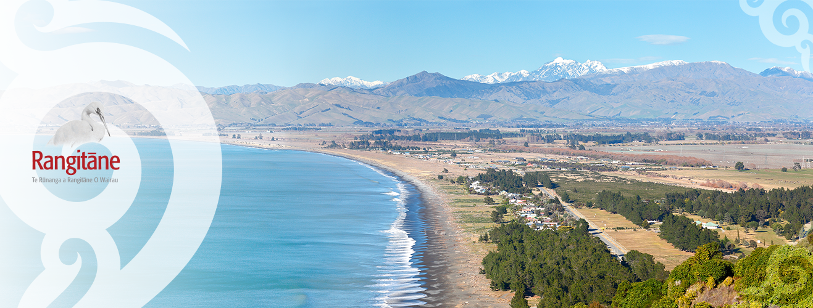
Rangitāne Whakamua!

